Slide 1
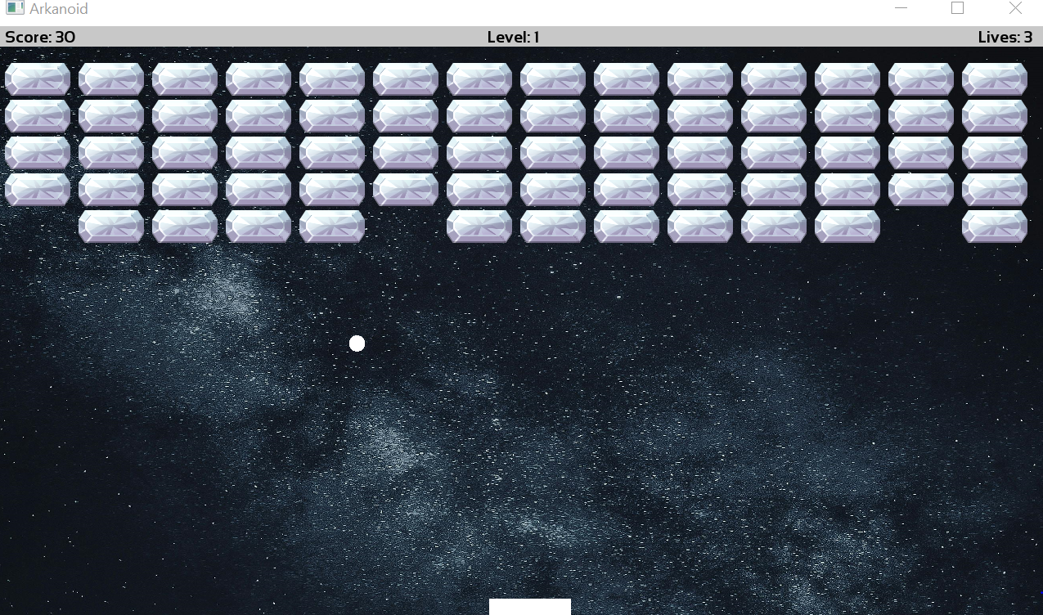
Arkanoid Game Development Using SFML
M. Haseeb
Ahmed
Mian M. Haziq

Slide 2
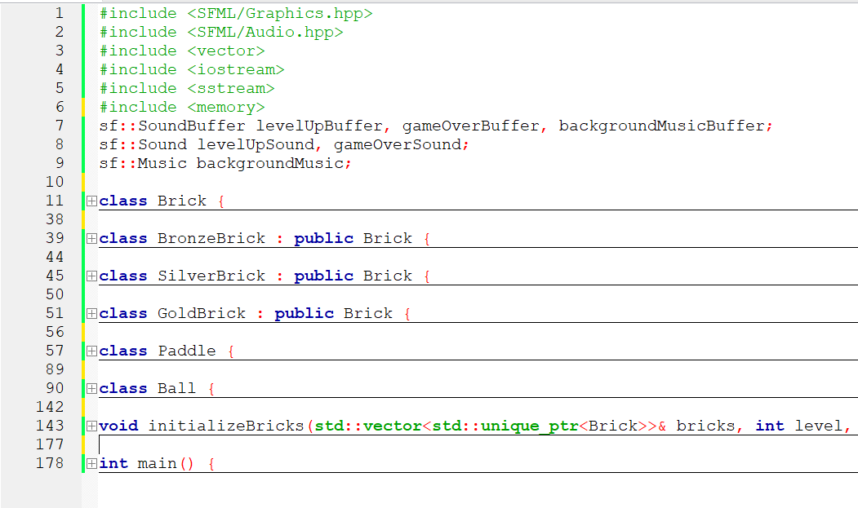
INTRODUCTION
The 'Arkanoid Game Development Using SFML' project is an object-oriented programming endeavor that focuses on creating a classic arcade game. The goal is to develop a functional and visually appealing Arkanoid game using the SFML (Simple and Fast Multimedia Library) framework.

Slide 3



Introduction
Classic Game: Arkanoid
Project Overview
Key Goals
Arkanoid is a beloved arcade game where the player controls a paddle to bounce a ball and break blocks.
The purpose of this project is to develop an interactive Arkanoid game using the SFML (Simple and Fast Multimedia Library) and Object-Oriented Programming (OOP) principles.
The key goals of this project include learning SFML, improving programming skills, and creating a engaging, interactive game experience.
This introduction provides a high-level overview of the Arkanoid game and the goals of the project to create an interactive version using SFML and OOP principles.

Slide 4
Objective
Primary objective
Develop a video game that showcases the implementation of Object-Oriented Programming (OOP) concepts, utilizes the Simple and Fast Multimedia Library (SFML) for graphics, and incorporates engaging game mechanics.
OOP Concepts
Demonstrate proficiency in applying fundamental OOP principles, such as encapsulation, inheritance, and polymorphism, to create a well-structured and maintainable game codebase.
SFML Graphics
Leverage the SFML library to create visually appealing and responsive game graphics, including 2D sprite rendering, animation, and user interaction.
Game Mechanics
Design and implement diverse game mechanics that provide a compelling and enjoyable gameplay experience for the user, such as player movement, collision detection, scoring, and level progression.

Slide 5

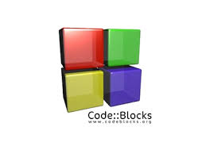
Tools Used
SFML (Simple and Fast Multimedia Library)
Cross-platform library for creating multimedia applications, including 2D games
Code::Blocks IDE
Open-source, cross-platform C/C++ IDE used for development and debugging

Slide 6



Project Methodology
Develop a detailed design for the game, including the overall structure, user interface, and game logic. Create a flowchart or diagram to illustrate the game flow.
Conduct a thorough analysis of the game requirements, including player interactions, game mechanics, and technical specifications.
Define project objectives, scope, timeline, and resources. Gather requirements from stakeholders and establish the project plan.
Implement the mechanism to capture user input, such as mouse clicks or keyboard presses, and translate them into game actions.
Project Initiation
Analysis
Design
Player Input
Ball Movement
Collision Detection
Score Update
Game State Handling
Implement the logic for ball movement, including velocity, acceleration, and trajectory calculations based on the user input and game mechanics.
Develop a system to detect collisions between the ball and game elements, such as walls, boundaries, and other game objects.
Implement the logic to update the player's score based on the game events, such as successful hits or reaching certain milestones.
Manage the game state, including the current score, level, and overall game progression. Implement the necessary logic to handle transitions between different game states, such as start, pause, and end.

Slide 7
Game Features and Implementation
Paddle Control
Ball Mechanics
Brick-Breaking Mechanics
The paddle is controlled by the player's mouse or keyboard input. It moves horizontally to the left and right, allowing the player to position the paddle to intercept the ball. The paddle's position is updated based on the user's input, ensuring smooth and responsive controls.
The ball's movement is governed by physics-based calculations. The ball bounces off the walls, paddle, and bricks, with its trajectory and speed affected by these collisions. The ball's initial velocity and direction are set at the start of the game, and its position is updated on each frame to create the ball's movement.
The game features a grid of bricks that the player must break by hitting them with the ball. Each brick has a certain number of 'hits' it can take before it is destroyed. When the ball collides with a brick, the brick's hit count is decremented, and if it reaches zero, the brick is removed from the game.
Scoring System
Game Levels
The player's score is increased each time a brick is destroyed. The number of points awarded per brick is based on the brick's position in the grid, with bricks higher in the grid being worth more points. The current score is displayed on the screen, and the player's high score is saved and tracked across game sessions.
The game features multiple levels, each with a unique arrangement of bricks. As the player progresses through the levels, the brick patterns become more complex, and the game's difficulty increases. The player must clear all the bricks in a level to advance to the next one, providing a sense of progression and challenge.

Slide 8
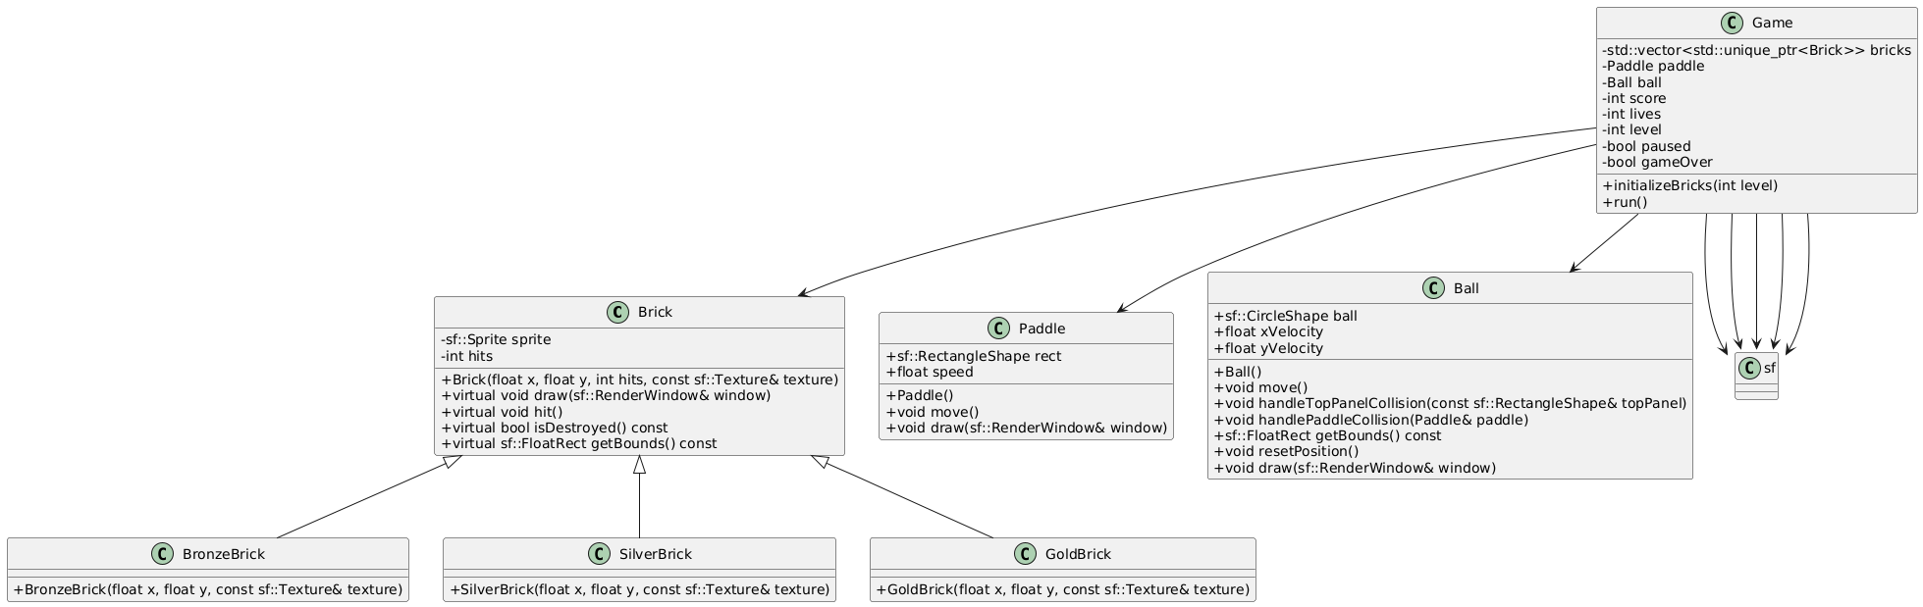

Slide 9







Challenges Faced and Solutions
Collision Detection
Handling Multiple Objects
Optimizing Performance
Lighting and Shading

Slide 10
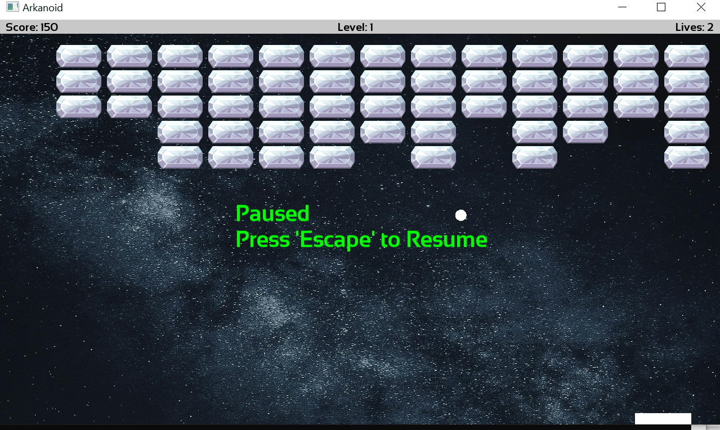
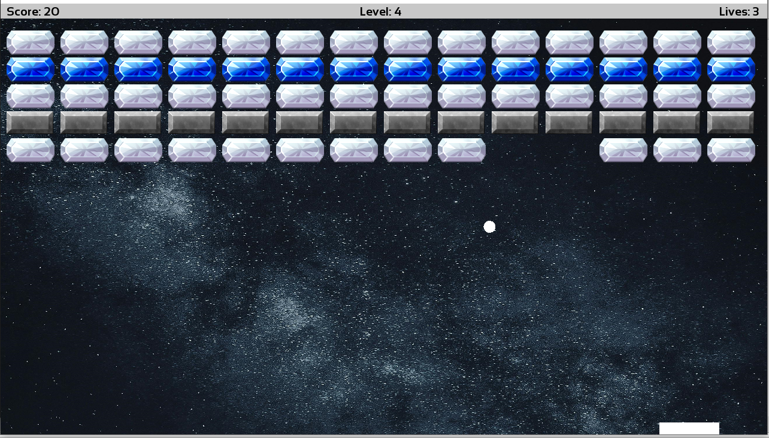
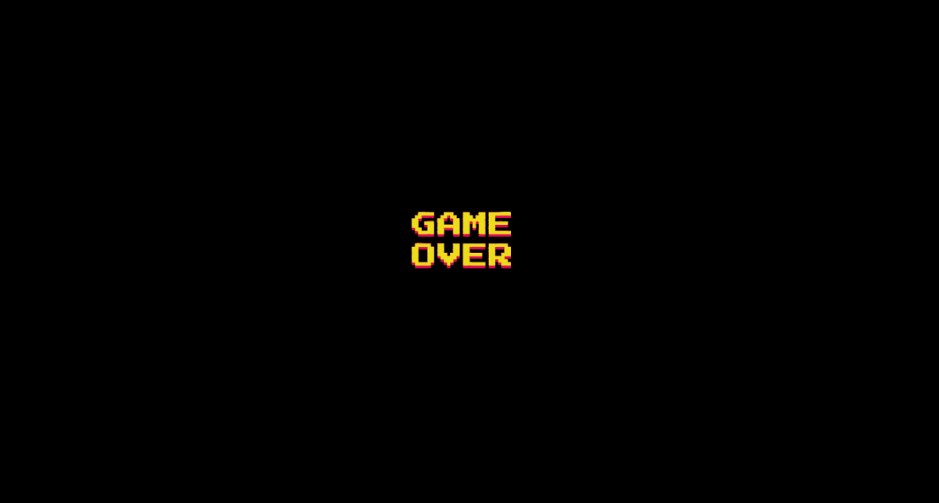
Outcome and Results
Final Game Design
Gameplay Mechanics
Dynamic Lighting and Effects
The game features a detailed and immersive 3D world with vibrant colors and intricate environments. Screenshots showcase the polished visual style and attention to detail.
The game's unique control scheme allows for intuitive and responsive movement, with a variety of abilities and actions that players can perform to navigate the world and interact with objects.
The game utilizes advanced lighting and visual effects to create a stunning and atmospheric experience, with dynamic shadows, particle effects, and environmental details that enhance the overall visual impact.

Slide 11




Future Improvements
Power-Ups
Advanced Levels
Multiplayer Mode
Enhanced Graphics
Introduce new power-ups that can provide temporary boosts or special abilities to the player, such as invincibility, increased speed, or the ability to destroy multiple obstacles at once.
Develop more challenging and complex levels with unique obstacles, traps, and terrain to keep players engaged and motivated to progress further.
Implement a multiplayer mode that allows players to compete against each other in real-time, either locally or online, to add a social element and increase replayability.
Improve the visual quality of the game by leveraging the latest graphics technologies, such as higher resolution textures, smoother animations, and more realistic lighting effects, to create a more immersive and visually appealing experience.
By implementing these suggested improvements, the game can evolve and provide players with a more engaging, diverse, and enjoyable experience, ensuring its longevity and continued success.

Slide 12
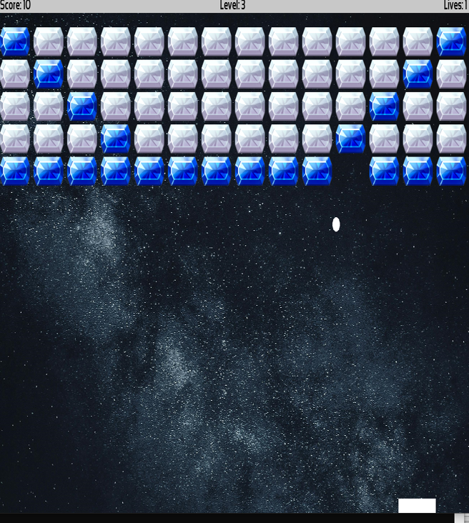
Conclusion
Arkanoid game project effectively showcases key programming concepts such as object-oriented design, event handling, and real-time game mechanics. Using SFML for graphics, sound, and input handling, the game is structured around modular components like bricks, paddles, and balls, with smooth collision detection and dynamic gameplay.

